Slide 1
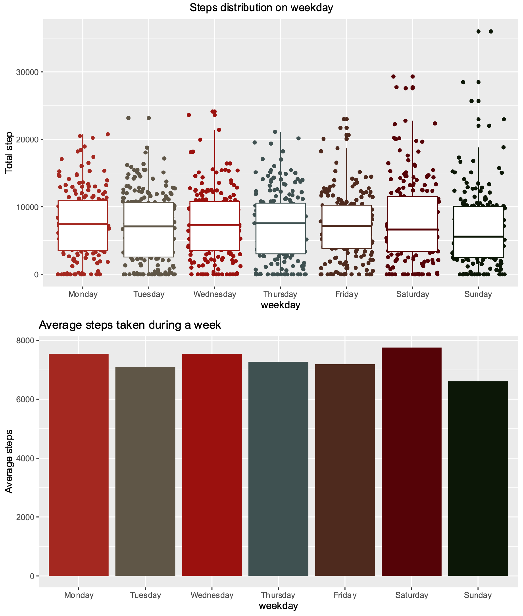
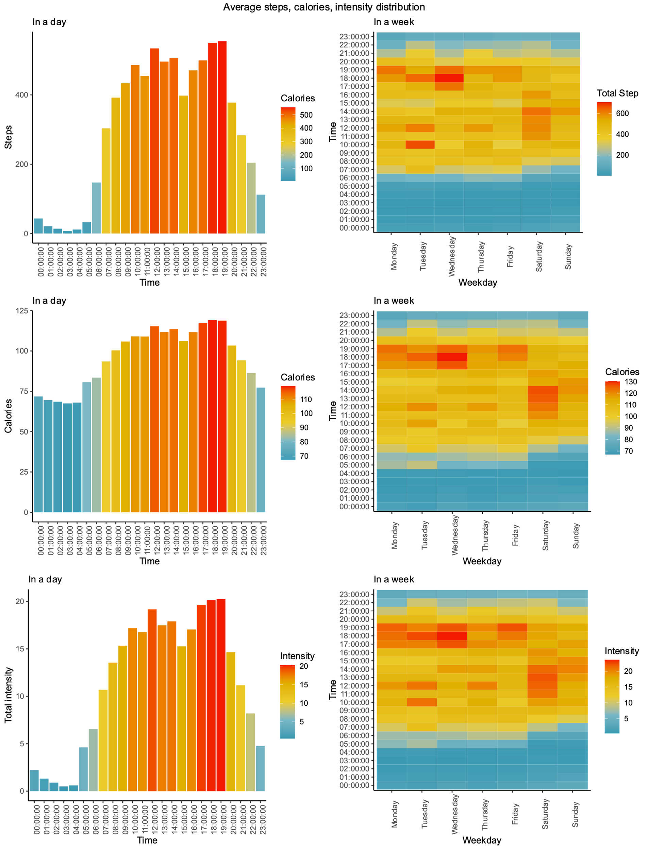
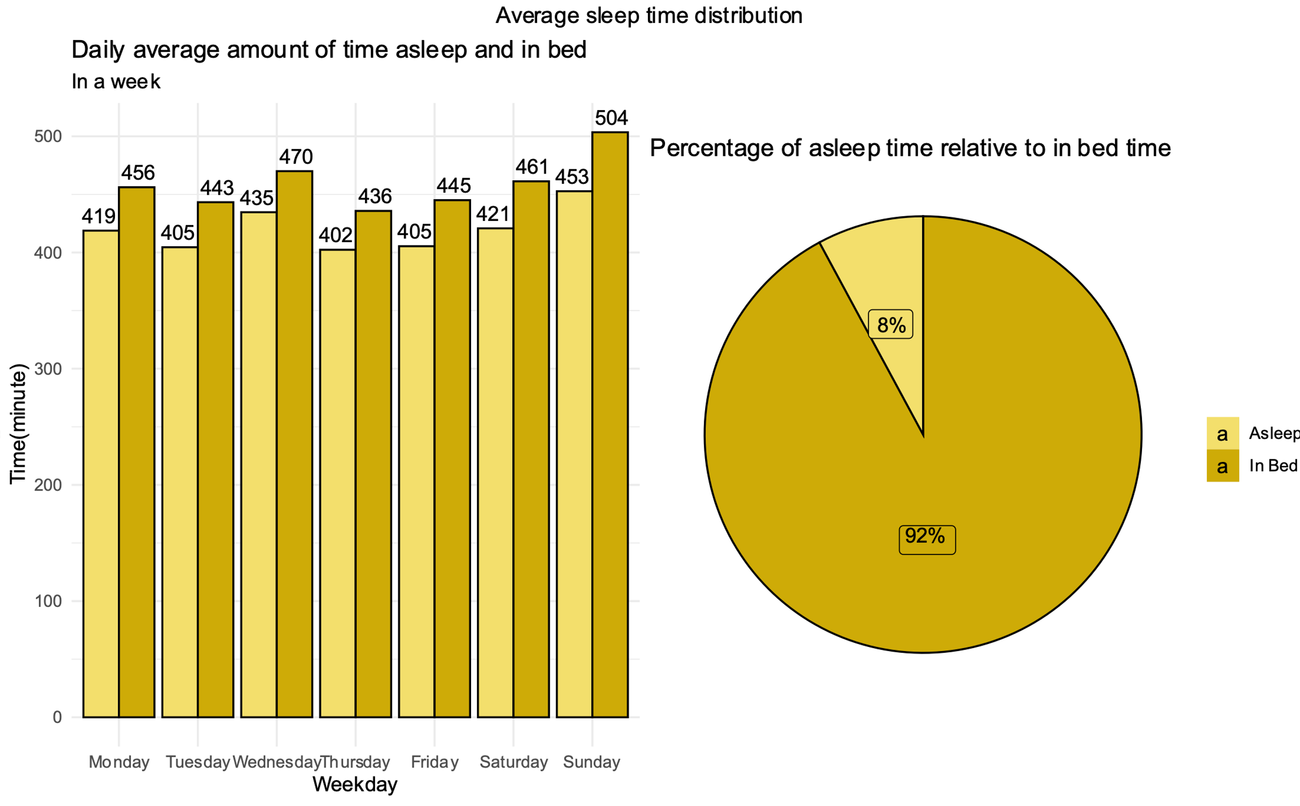
Bellabeat
Marketing data analytics case study
Google Data Analytics capstone project
Mason Phung – January 2023

Slide 2
Introduction
Bellabeat - Sweden high-tech company
Founded by Urška Sršen and Sando Mur in 2013, Bellabeat is known not only as a rapid developing high-tech company that manufactures health-focused smart products, but also a tech-driven wellness company for women.
By 2016, Bellabeat had launched multiple products along with opening many branches worldwide. Bellabeat products can be found on their own e-commerce channel as well as numerous online retailers.
Realizing the huge opportunity to grow in the online market, Bellabeat has been focusing on analyzing consumer usage data in order to understand the habit and preferences of their potential customers.
Bellabeat current products:
Bellabeat app
“Leaf” (tracker, can be worn as accessories)
“Time” (watch)
“Spring” (water bottle with smart tech)
Bellabeat membership (subscription based)

Slide 3
Case summary
Key focus & audience
The case study will focus on:
The analysis of the smart device usage data (Provided by the company)
Suggestions for future marketing campaigns of Bellabeat’s products based on the insights
Key questions:
What are some trends in smart device usage?
How could these trends apply to Bellabeat campaign?
How could these trends help influence marketing strategy?
Stakeholders:
Bellabeat executive team
Bellabeat Marketing team

Slide 4
Case summary
Work direction
Download data from source website & process usable data
Clean data (details in markdown and coding file)
Analyze datasets to find insights
Visualize & conduct report

Slide 5
Analytics
Data
Basic information:
Fitbit Fitness Tracker data pack is generated by respondents to a distributed survey via Amazon Mechanical Turk between 2016/03/12 to 2016/05/12. The data is available on Kaggle and Mobius as open-source.
The data pack includes 18 Comma-separated values files (.csv) record the activities, calories, intensities, foot steps and weight loss of 35 users in 62 days.
Only daily activity, daily sleep and hourly activity datasets will be used for this case study

Slide 6
Comments
Data limitations
Small data size with only local population, which may not represent the whole population
Lack of demographics data
Data’s short date length
-> Bias possibility
Hourly and daily datasets are synced but still have some small errors

Slide 7
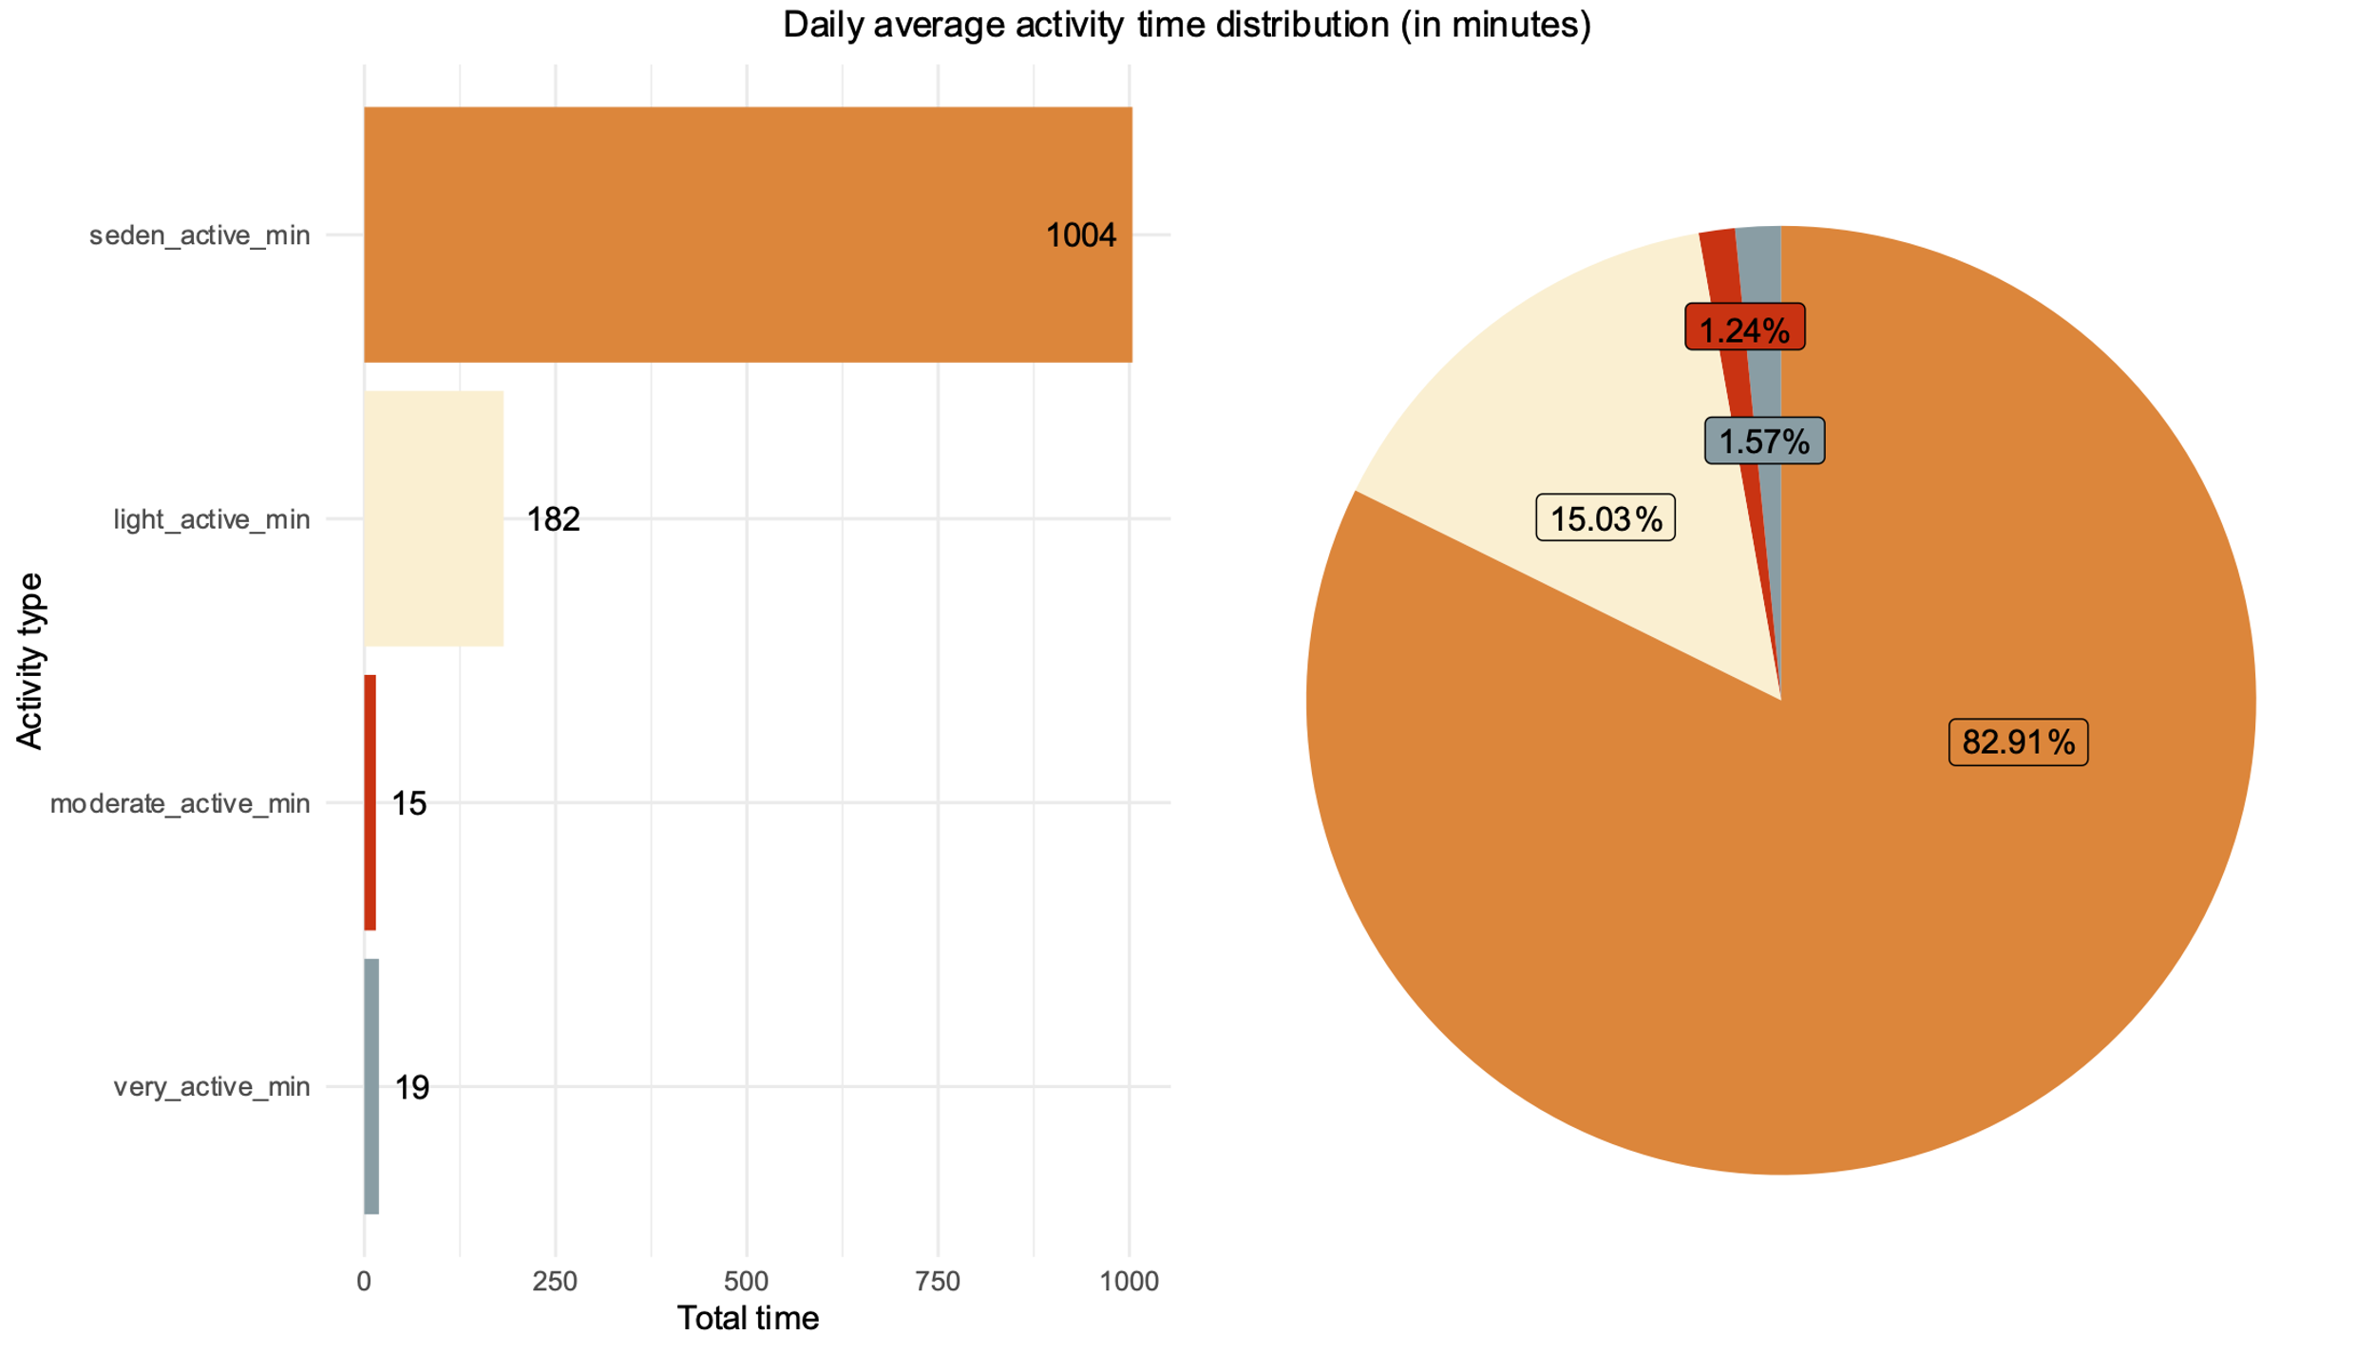
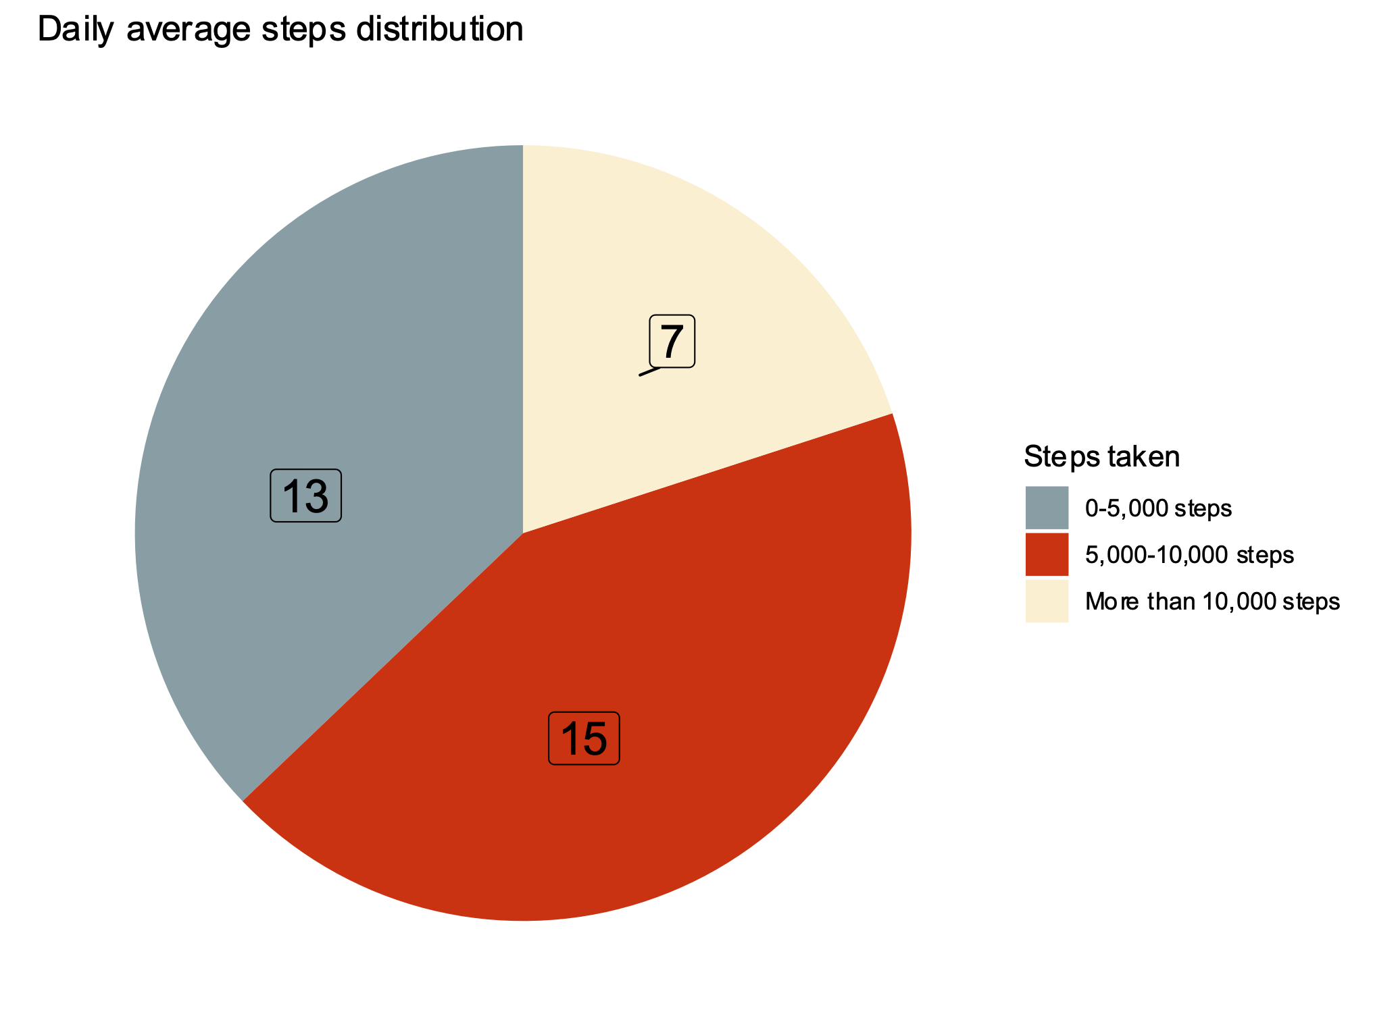
Analytics
Daily activity
On daily average
82.9%
17.1%
7281
Sedentary time
Active time
Walking steps
16.6
3.6
5.2 km
Sedentary hours
Active hours
Walking distance
People spend most of the time in the day sedentary (82,9%) and about 3.6 hours a day for different types of activities.
The amount of time recorded from the participants in the data suggests that people wear the tracker most of the time in a day, even during normal activities or workout.
Majority (80% - 28/35) of the participants walk less than 10,000 steps a day*
* According to researches, taking at least 10,000 steps a day is suggested for a strong health

Slide 8
Analytics
Daily activity
Most active days: Saturday, Monday, Wednesday
During the week, people tend to walk less than 15,000 steps
In the weekend, the boundary opens up to more than 30,000 and many more people take more than 15,000 steps a day.
Sunday is the least active day, with the least average steps taken

Slide 9
Analytics
Daily activity
Common active time: from 7h to 21h
12h-14h and 17h-19h are the two most active time with the highest amount of steps taken, calories burnt and total intensity
These 2 time periods are all meal time (while the latter is the getting off work time, workouts and also people may move more to prepare for their dinner)
At the weekend, people are usually start their days later but move less in the evening and still having the same rest time at the end of the day.
The heat maps suggest the active pattern of normal office workers

Slide 10
Analytics
Daily sleep
Only
24
users
Sunday
Wednesday
Possess sleep records
out of 35 users
Longest sleep
7
hours
Users spend on average
39
mins
Average sleep time
In bed without sleeping
11 users don’t wear the tracker device during sleep, this can be due to personal preference or the device’s lack of convenience issue (need more information).

Slide 11
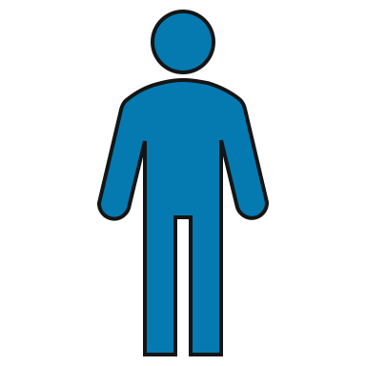
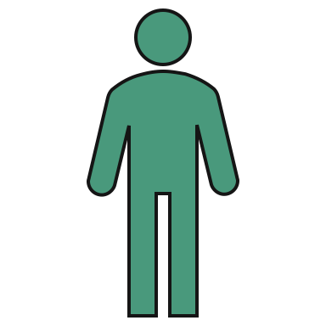
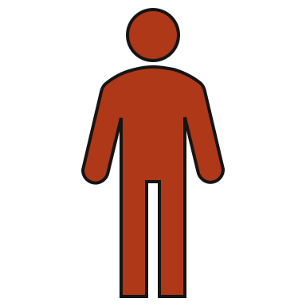
Analytics
Users’ segmentation
By daily average steps
Users will be divided into groups based on their daily average steps
13
people
Take less than 5,000 steps on daily average
15
people
Take from 5,000 – 10,000 steps a day
7
people
Walk more than 10,000 steps a day

Slide 12
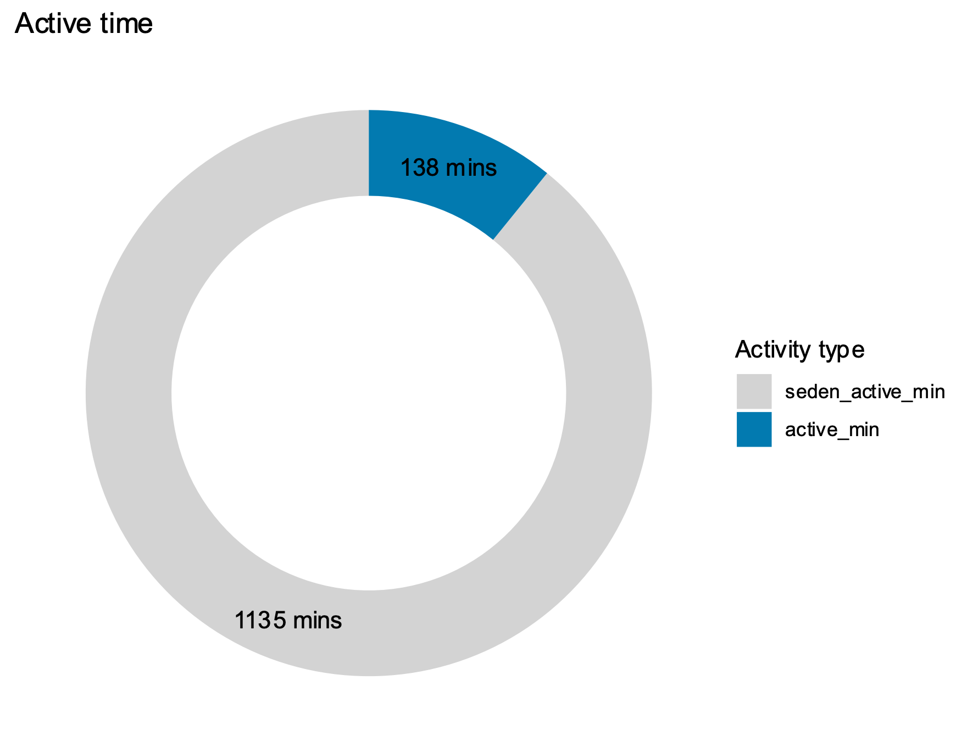
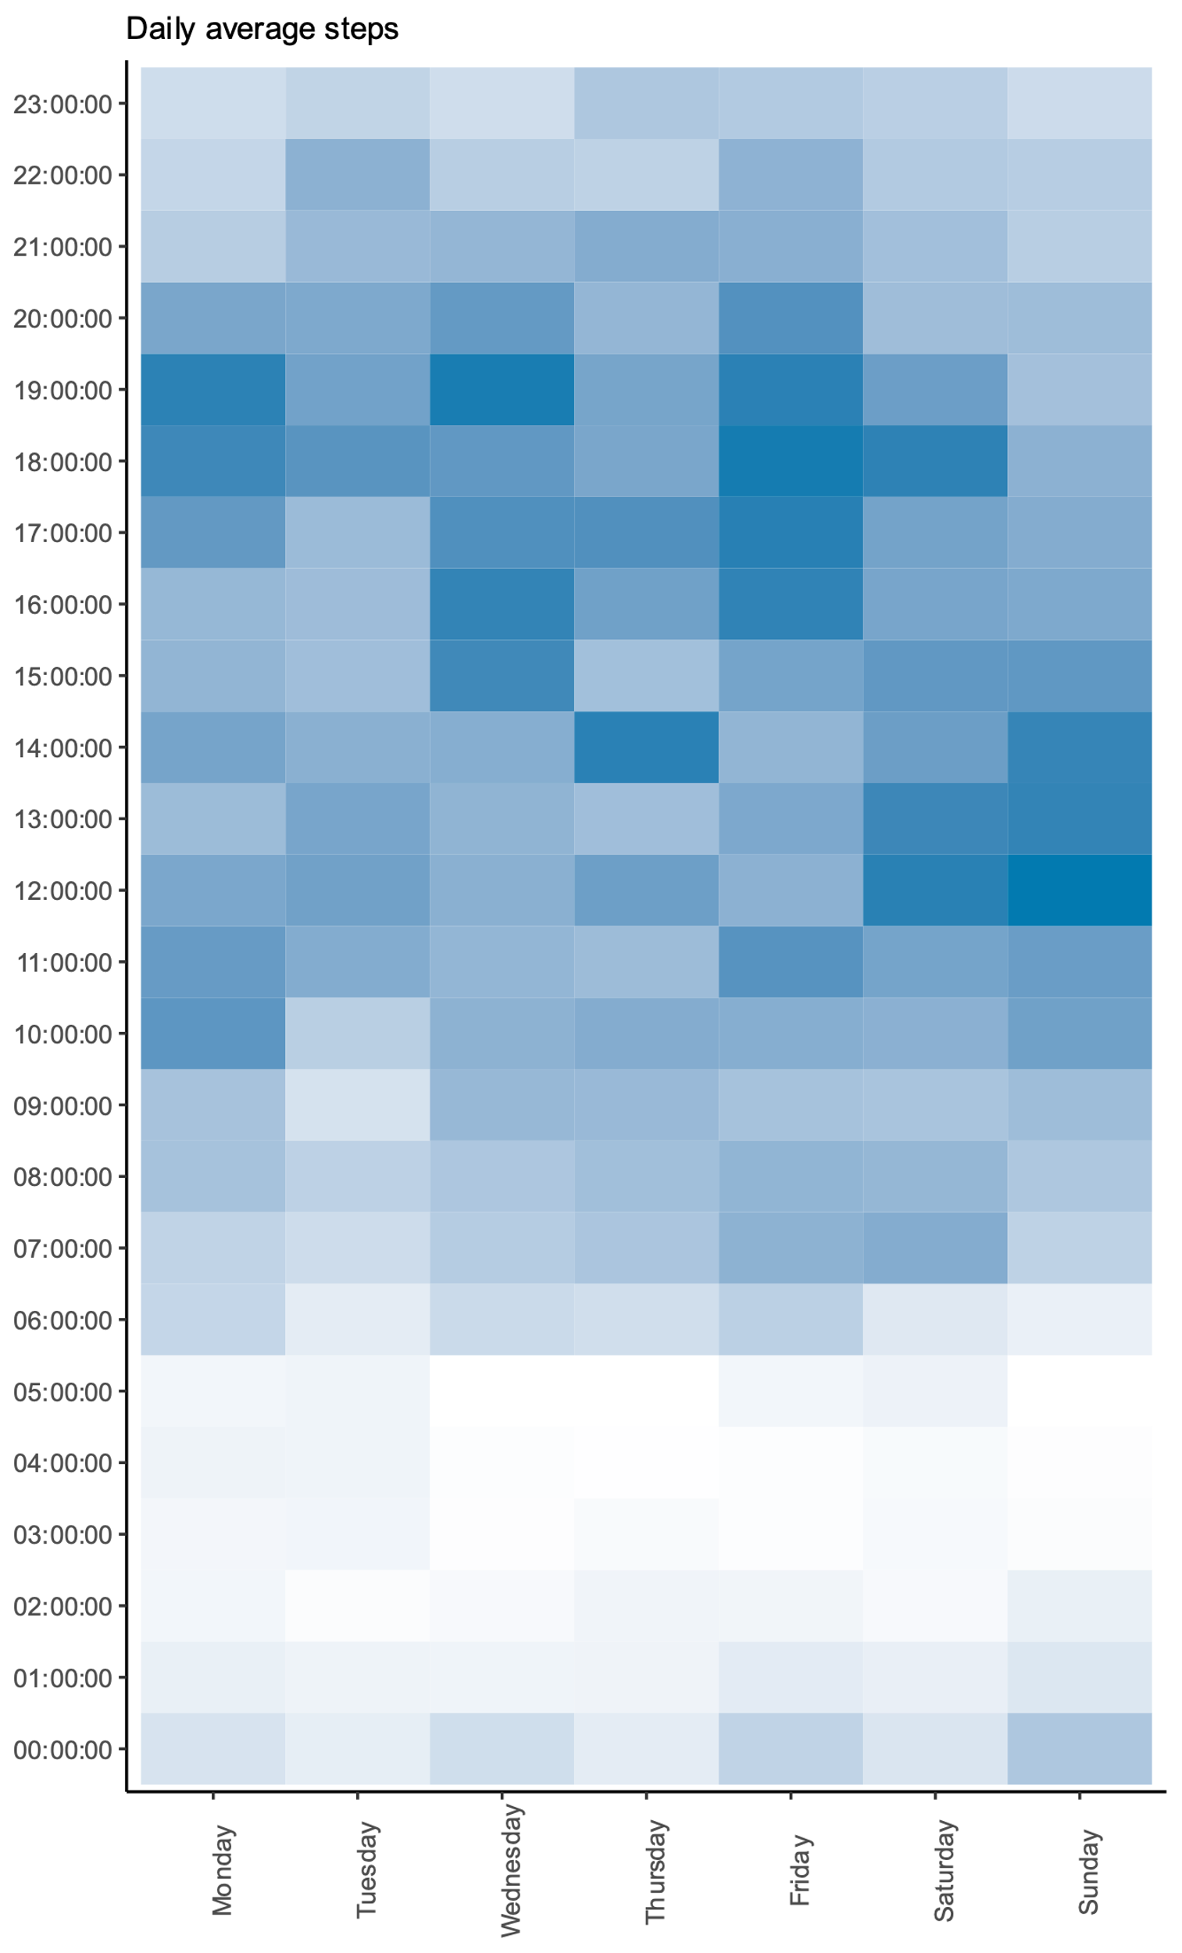
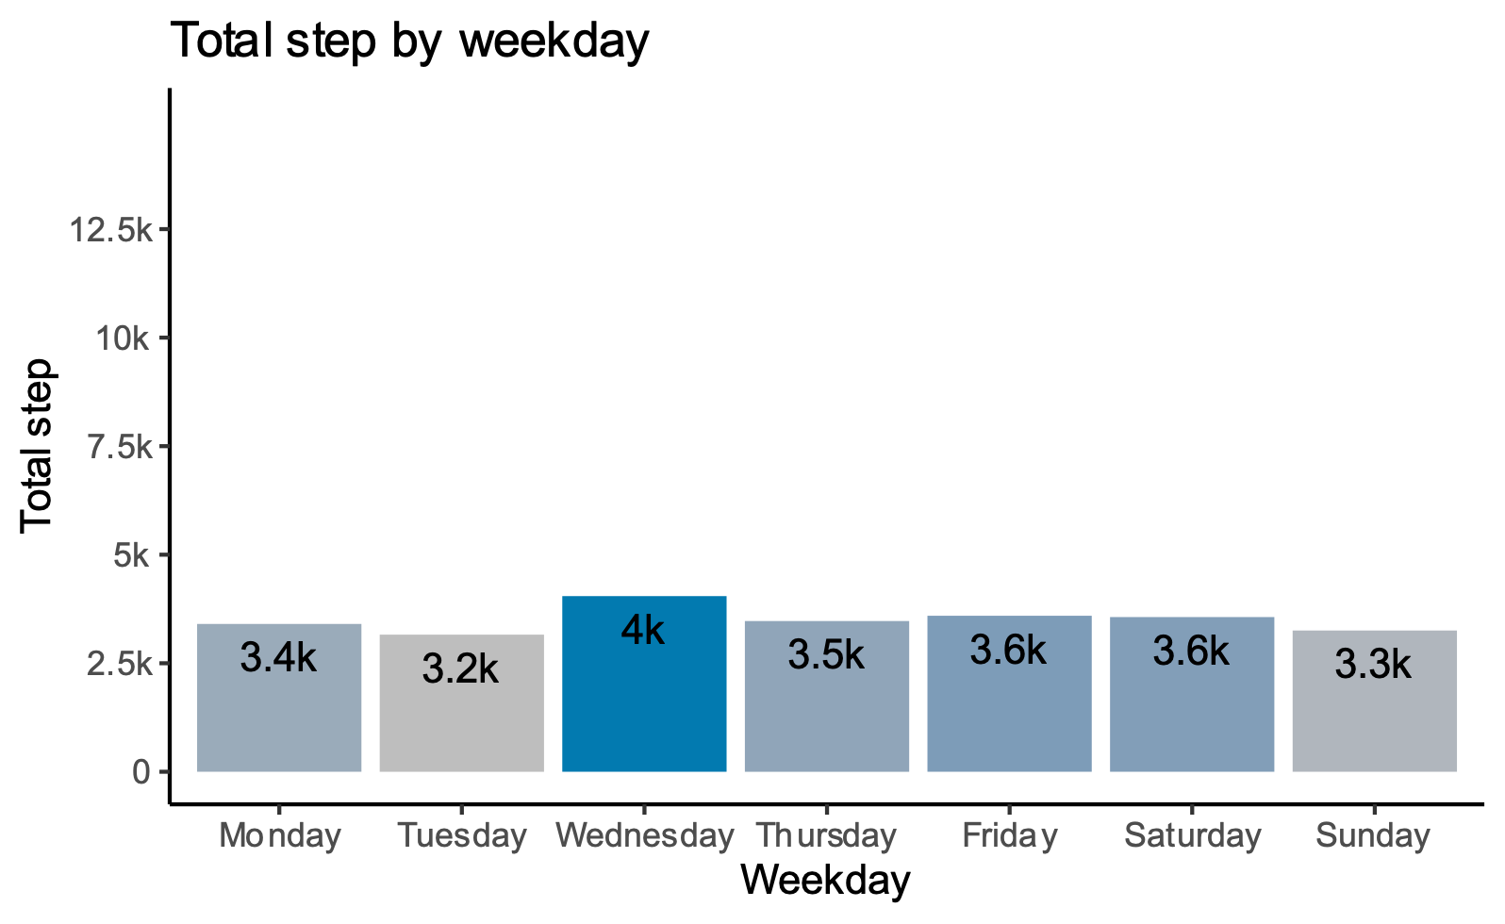
Analytics
G1: Take less than 5,000 steps on daily average
36
2.15 km
Wednesday
Average tracker using days
Average daily
distance travelled
Most active day
12%
This group of users only spend 2 hours avg/day active, including light & intensive activities
Most active time in a day at 17-19pm
Heatmap shows evidence of frequent late night activity, at sleep hours
Aside from Wednesday, others day’s activities are quite similar with not many differences in travelled steps
This group often wears the tracking device, with 4 days avg/week
The data suggests a pattern of office workers, not active and walk in short distance. Take not much exercise. There is a disordered pattern in activity.

Slide 13
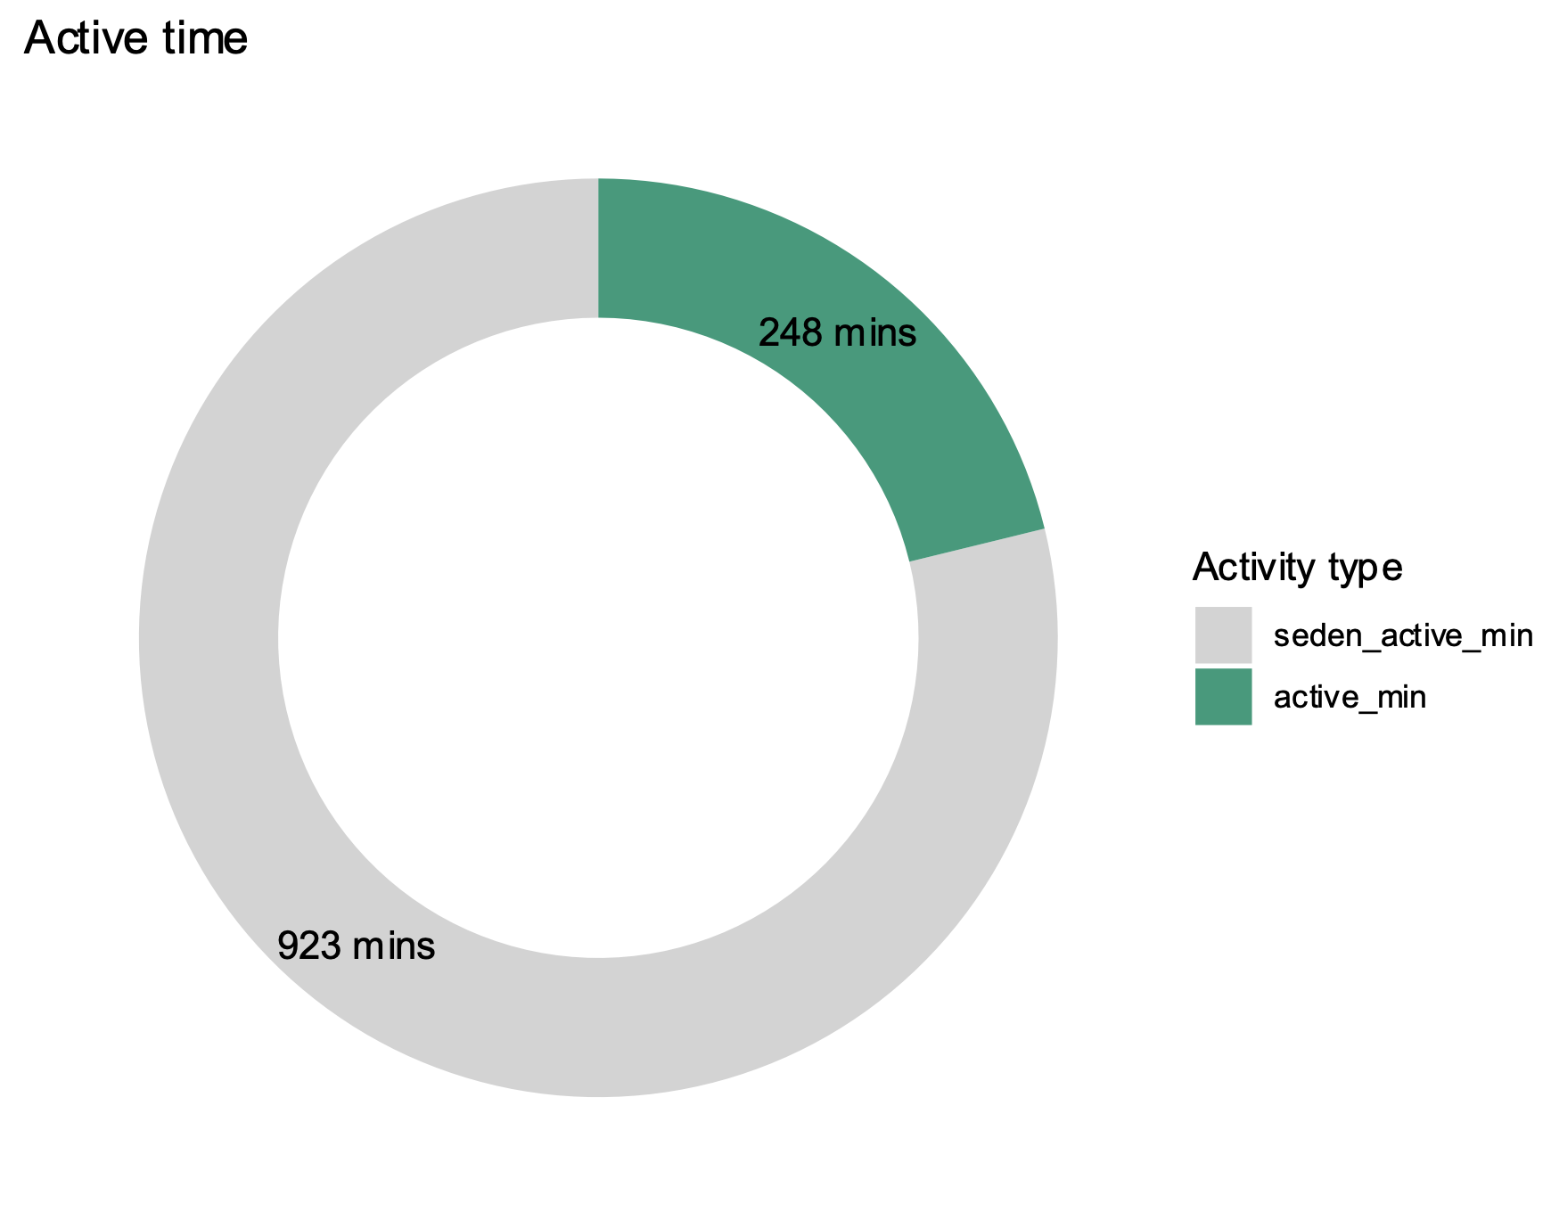
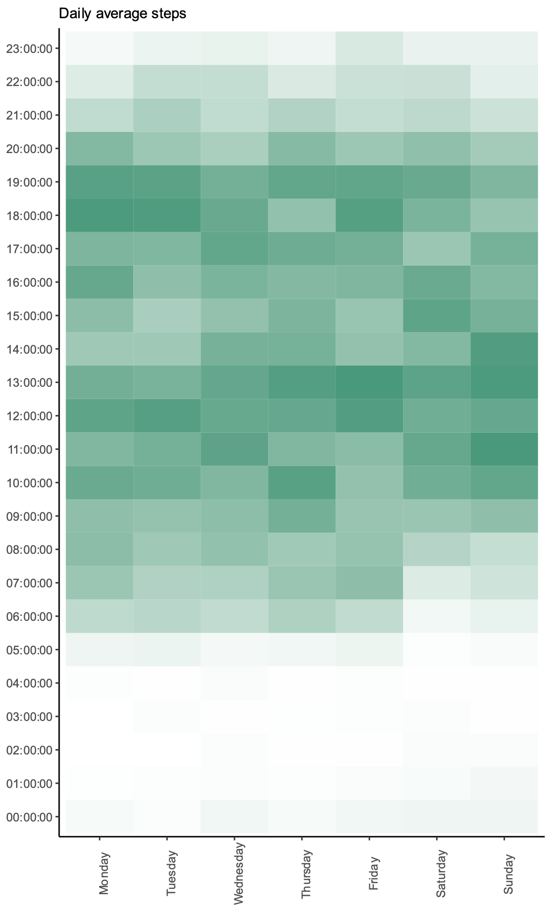
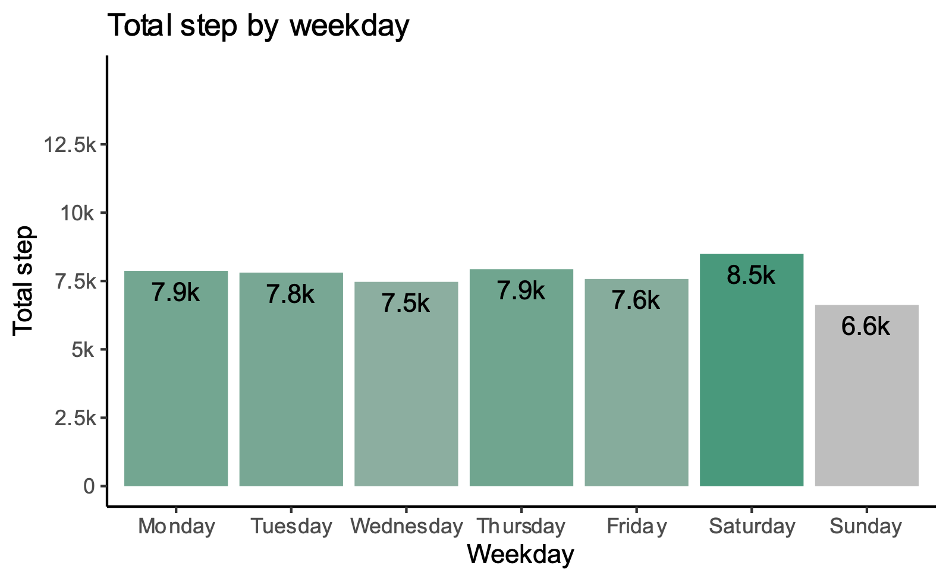
Analytics
G2: Take from 5,000 - 10,000 steps a day
40
5.42 km
Saturday
Average tracker using days
Average daily
distance travelled
Most active day
27%
This group of users spend 4 hours avg/day active, including light & intensive activities
Most active time in a day at 12-13pm and 18-19pm
Heatmap shows evidence of stricter weekly schedule compared to G1
Day usually starts at 6pm in weekdays and later 7~8pm at weekends
Less late night activity, sleep earlier compared to G1
Aside from the weekend, the activity amount of weekdays are similar
This group often wears the tracking device, with 4.4 days avg/week
The data suggests that users are fairly active and follow a similar activity habit constantly

Slide 14
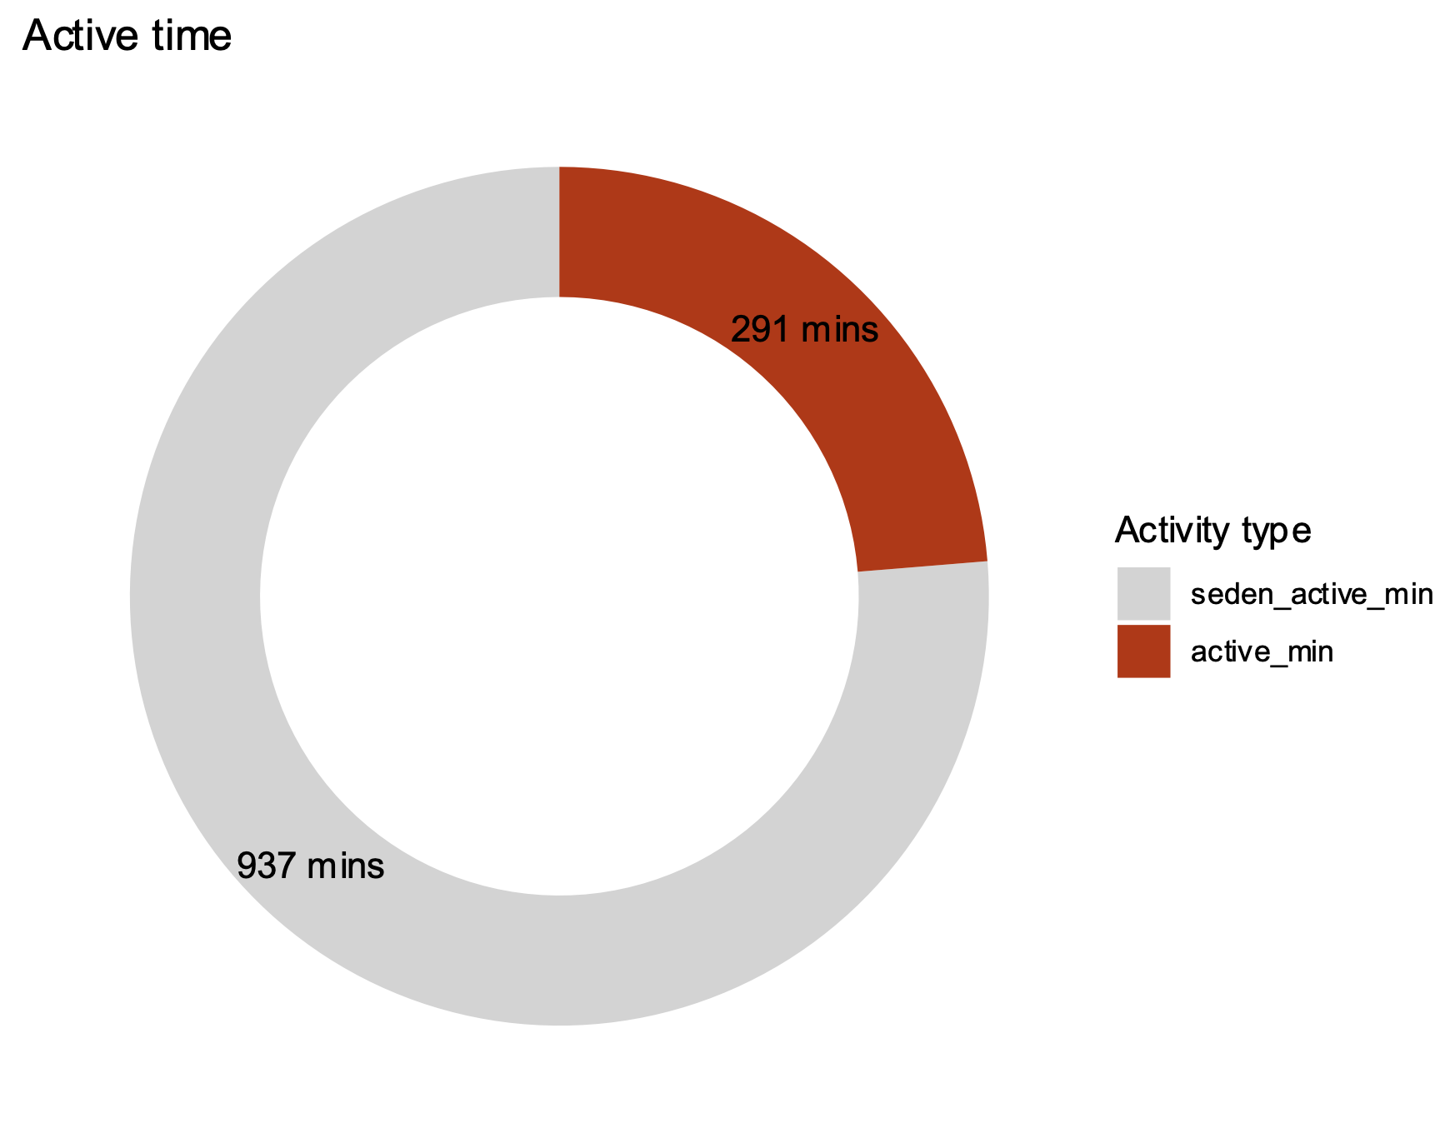
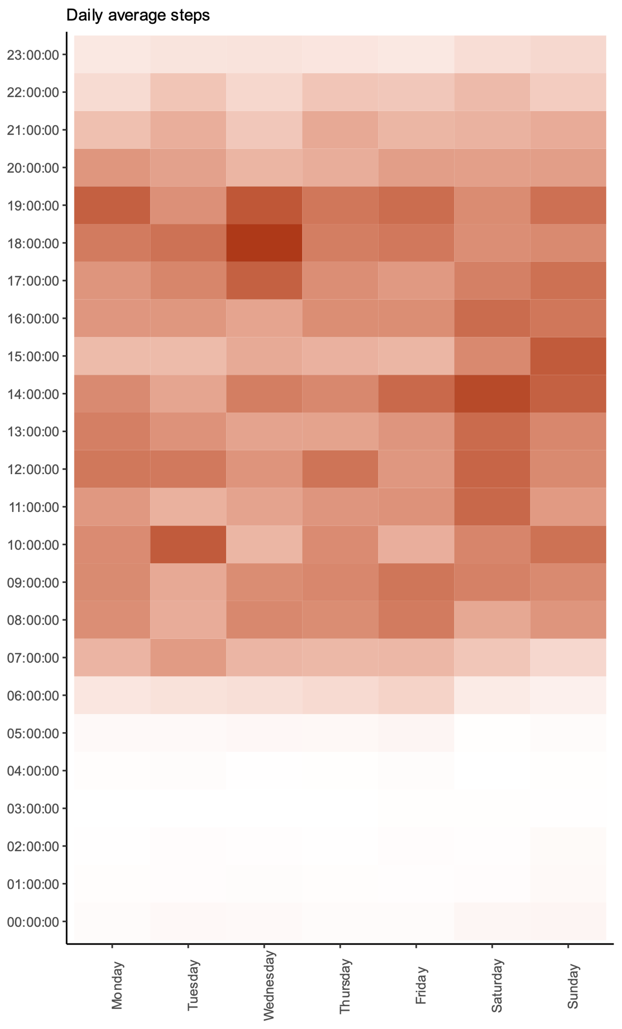
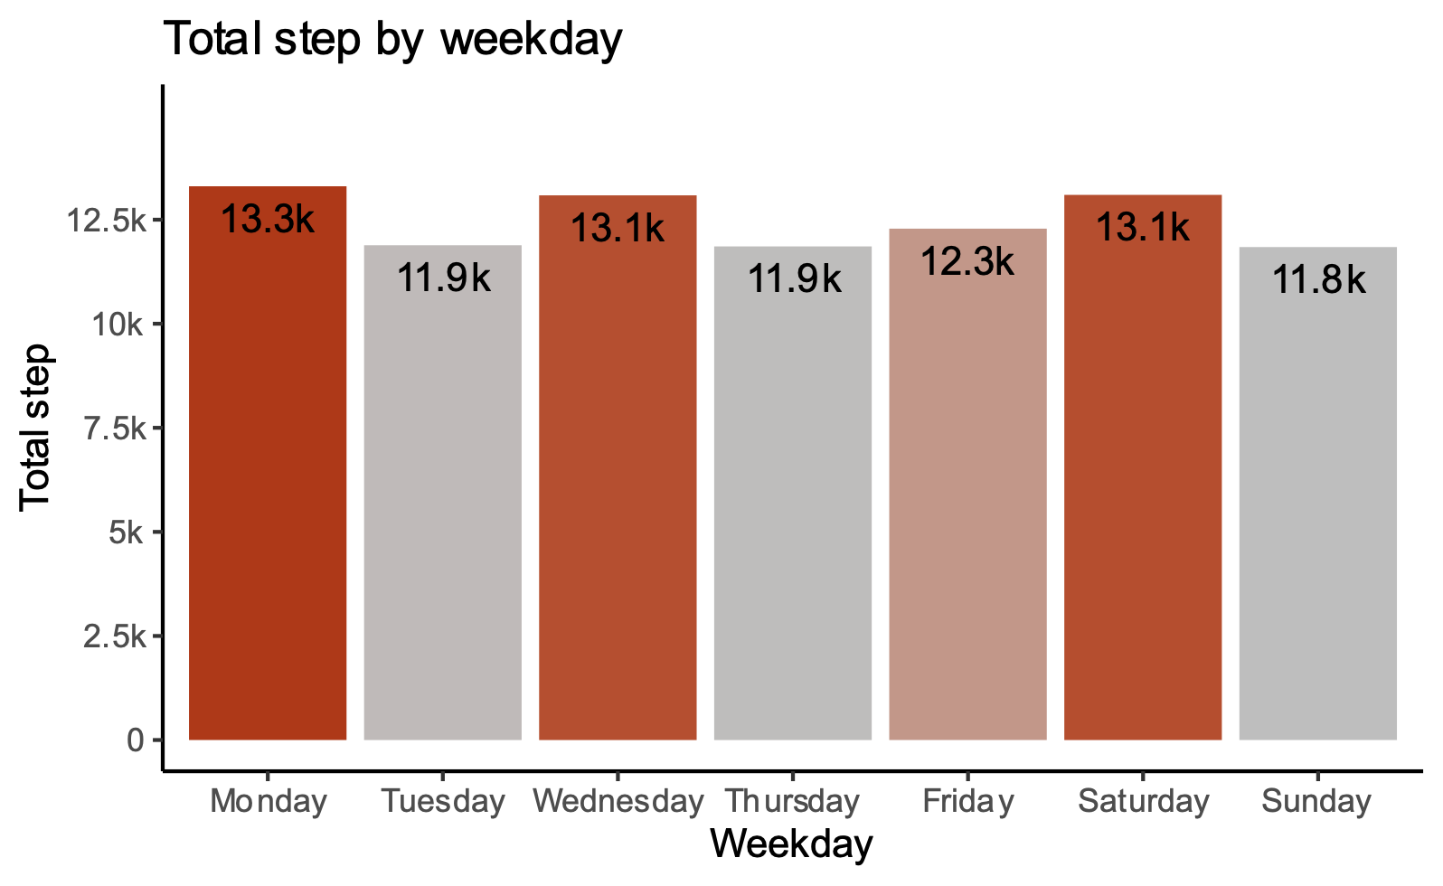
Analytics
G3: Take more than 10,000 steps a day
42
9.06 km
Monday
Average tracker using days
Average daily
distance travelled
Most active day
31%
This group of users spend 4.8 hours avg/day active, including light & intensive activities
Most active time in a day at 12-14pm and 18-19pm
Heatmap shows evidence of a very strict active schedule
Day usually starts at 6pm in weekdays and later 7~8pm at weekends
Less late night activity, nearly no activity from 0 am
Monday, Wednesday and Saturdays are considerably more active
This group often wears the tracking device, with 4.6 days avg/week
The data suggests a group of users that are very active and follow a similar activity habit constantly. They with spikes at Mon, Wed and Sat, this suggests that they might having a special exercise/activity on these days.

Slide 15
Comments
Insights summary
Tracker
Users wear the tracker most of the time in a day, through different types of activity
Active users are more likely to wear the tracker
31% of users doesn’t wear the tracker during sleep
Users only wear the tracker 63% of the time throughout the survey
Users’ active habits
Active users are more likely to follow a strict schedule
Users spend 83% of the time in a day being sedentary, only be active at certain time periods
User spend 84% of their active time doing light activities
Users are more active during meal time
Users rest more but travel more during the weekend
User’s sleeping habits
Users usually have a constant sleep time of ~ 7 hours daily
Users spend a considerable amount of time ~ 0.65 hours in bed without sleep

Slide 16
Comments
Suggestions
Provide new tracking modes for different types of activities
High amount of time not wearing the tracker shows that users may not feel comfortable with the design → consider redesign the tracker to fit different situation, environment, temperature..
Create different user profiles, features for different user groups from less active to very active users.
Aside from sedentary activities, create new feature for light activities as it takes 84% of all the average activities in a day
Create a guide or an auto-bot to as an assistant to help reminding, scheduling and reporting
Provide health reports
Day-end report: people usually spend some time to relax, restless before sleep, so we can provide a report of their health status during the day.
Week-end report on Sunday when people usually spend their time to rest, be less active and may want to take a look of what had happened through out the week
Encourage users to be more active by adding:
Reward system: game or an experience count system with level-up mechanism
Notifications: regular reminds customers to encourage them to be more active

